Slide 1
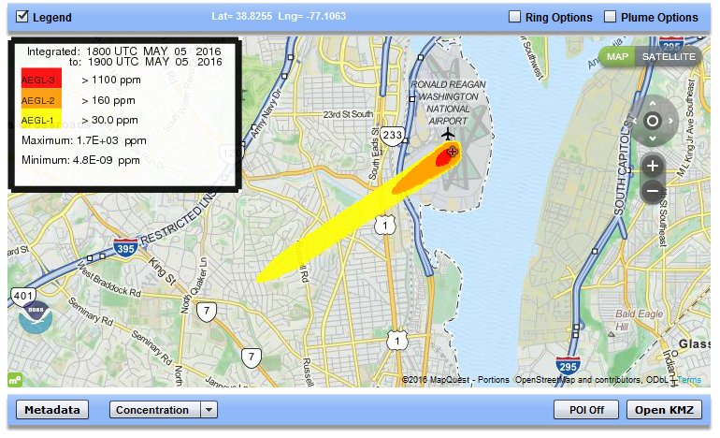
HYSPLIT/ALOHA Demonstration
Glenn Rolph
OAR Air Resources Laboratory
June 21, 2016

Slide 2
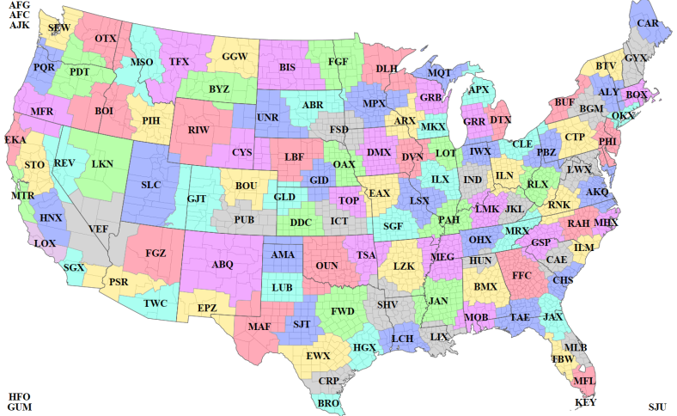
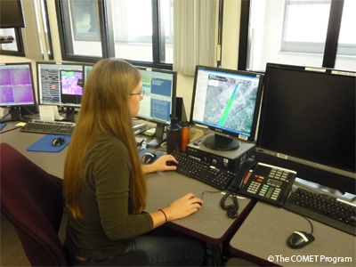
Background Information
ARL supports the 122 local National Weather Service’s Weather Forecast Offices (WFOs) with HYSPLIT atmospheric dispersion products to assist them with their decision support role in the local community.
In 2007, a web-based HYSPLIT system was made available to the WFOs so they could run the model directly without contacting NCEP for a simulation, as done previously.
In 2013, an enhanced web site was made available that included a more defined chemical source term model (ALOHA) through a cooperative effort with the NOAA National Ocean Service’s Office of Response and Restoration (OR&R), developers of the CAMEO/ALOHA software suite.
122 NWS Weather Forecast Offices
Notes:
ARL’s support of NOAA’s commitment to prevent disaster and protect the health and welfare of the general public and emergency response personnel, led to the development of a suite of weather and dispersion products, the majority of which are now web-based. One application that will be demonstrated today, came about as a result of our close relationship with the National Weather Service and, in particular, with the Weather Forecast Offices (WFOs), who had a need to provide the first responders and emergency managers with dispersion model support in addition to the meteorological support they were already providing.
This need led to the development of an interface in 2007 (which continues to be enhanced today) to provide the first responders with a forecast dispersion product that best meets their needs and has the local meteorological knowledge of the forecaster to support the dispersion product.
One application that is available to the WFOs, and will be demonstrated today, is the ability to model the release and transport of airborne hazardous chemicals. Beginning about 7 years ago, ARL began a collaborative effort with the NOS Office of Response & Restoration (ORR), to provide a chemical source model for HYSPLIT similar to the CAMEO/ALOHA model first responders are already familiar with and that ORR developed. This effort would allow for longer range simulations than CAMEO/ALOHA could provide using a Gaussian plume model.
In 2013, the complete HYSPLIT/ALOHA modeling system was formally made available to the WFOs along with other enhancements to the overall web site.
In 2014 the development team was awarded the NOAA Administrator’s Award for their effort.

Slide 3
CAMEO Software Suite
The ALOHA component provides time-varying chemical emissions to HYSPLIT.
CAMEO Chemicals
Tier2 Submit
ALOHA
MARPLOT
CAMEOfm
Chemical Property Database
Source and Dispersion Model
Mapping Application
Planning Data
Create
Chemical Inventory
Notes:
ALOHA is one of five software programs that make up the CAMEO software suite that is produced jointly by NOAA and the EPA. All of the products can be downloaded for free from https://www.epa.gov/cameo
The suite is designed to help emergency responders and planners:
Access chemical property and emergency response information (in CAMEO Chemicals).
Model potential chemical releases (in ALOHA).
Display results on a map and get population estimates (in MARPLOT).
Manage chemical planning data for the 1986 Emergency Planning and Community Right-to-Know Act (in CAMEOfm and Tier2 Submit).

Slide 4
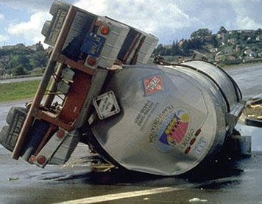
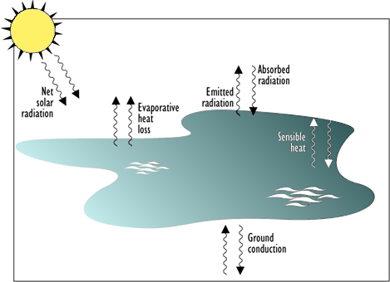
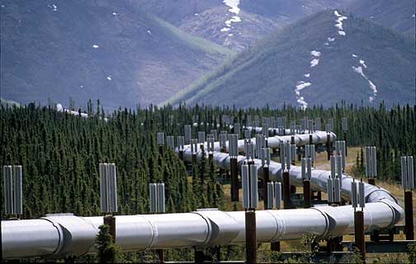
ALOHA Background
Image from solarstorms.org.
Tank
Puddle
Gas Pipeline
Gaussian and heavy gas dispersion algorithms
Designed for short-duration (< 60 min), short-range (< 10 km) incidents (no account for changes in wind direction/speed)
Multiple time-dependent chemical source models (tank, puddle, gas pipeline, and direct release to the atmosphere)
Used by thousands of first responders around the world
Notes:
A little background on ALOHA:
It’s composed of a Gaussian and a heavy gas dispersion algorithm
It’s designed for very short-duration (< 60 min) and short-range (<10 km) incidents
It has 4 time-dependent chemical source term models (tank, puddle, gas pipeline, and a direct release to the atmosphere option)
And no matter how the chemical is being released from its container or its physical state upon release, ALOHA model how the chemical vapor will disperse as its released.
Recently, a fire and an explosion model were added to the system, but for now only the toxic gas component is used with HYSPLIT

Slide 5
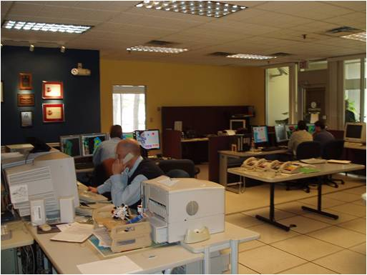
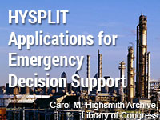
HYSPLIT Integration with ALOHA
WFO enters information on the chemical being released based on communication with the local emergency responder
ALOHA estimates how the chemical cloud escapes from the source over time.
HYSPLIT uses ALOHA time-dependent source strength values to calculate the plume further downwind than is generally acceptable by the ALOHA dispersion model
Output product shows a map of “Level of Concern” contours familiar to emergency managers.
Training provided to the WFOs through video conferencing and the development of a COMET study module (University Corporation for Atmospheric Research - UCAR).
A demonstration of this application will now be provided.
ARL Science Review, June 21-23, 2016
5
Notes:
ALOHA was selected in order to provide a more refined estimate of the time-varying chemical release rate for HYSPLIT, which up to that point only used a simple estimate of the total mass of material released at a constant rate over time.
The WFO discusses details on the chemical accident with the emergency responder to determine the inputs to ALOHA such as the chemical involved, the location of the leak, and the volume of the chemical estimated to be in the container.
After entering the information into the model through the web interface, ALOHA estimates the time-dependent source strength for use by HYSPLIT and output the results in units of “Levels of Concern,” which are familiar to the emergency responder for its effects on public health.
We developed several options for training the WFOs on the use of the system and interpretation of the results including, live video conferencing, COMET study modules, and web-based interactive training materials.

Slide 6
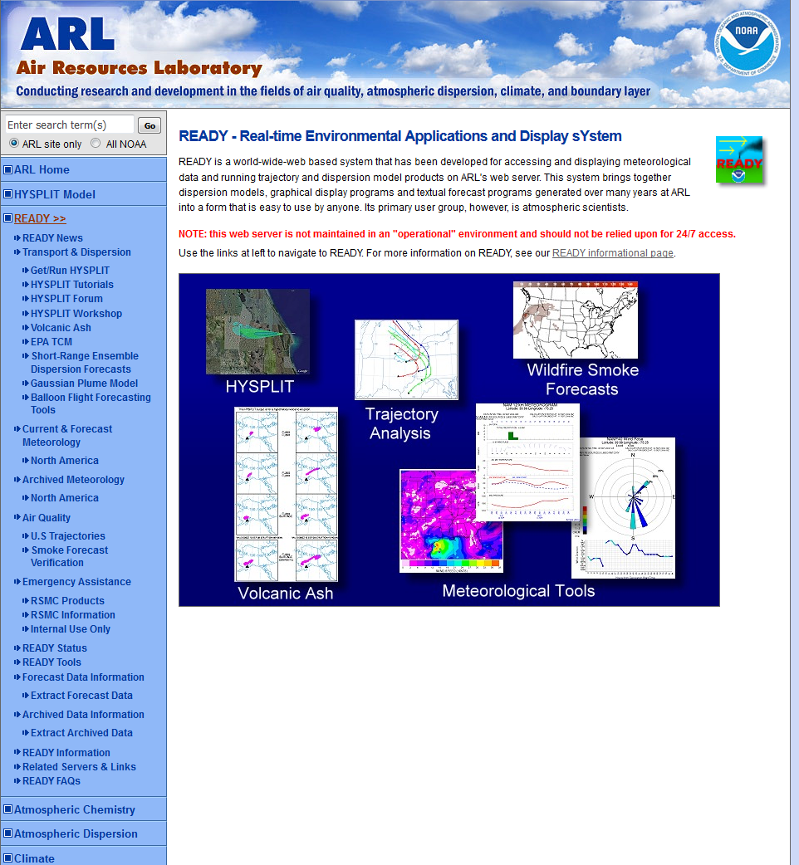
HYSPLIT/ALOHA Demonstration
ARL READY web site
http://www.ready.noaa.gov
Notes:
The Real-time Environmental Applications and Display sYstem (READY) is a web-based system, developed by the Air Resources Laboratory (ARL), for accessing and displaying meteorological data and running trajectory and dispersion model products on ARL’s web server. The system brings together dispersion models, graphical display programs and textual forecast programs generated over many years at ARL into a form that is easy to use by anyone. Since its development in 1997, thousands of users (largely atmospheric scientists) have generated products from READY for their day-to-day needs and research projects.
This demonstration will show the procedure a WFO would undertake to produce a chemical hazard HYSPLIT model forecast and how that product is made available to the local emergency manager or responder.
In this demonstration of the HYSPLIT/ALOHA system for WFOs, we will click on the link to Get/Run HYSPLIT.

Slide 7
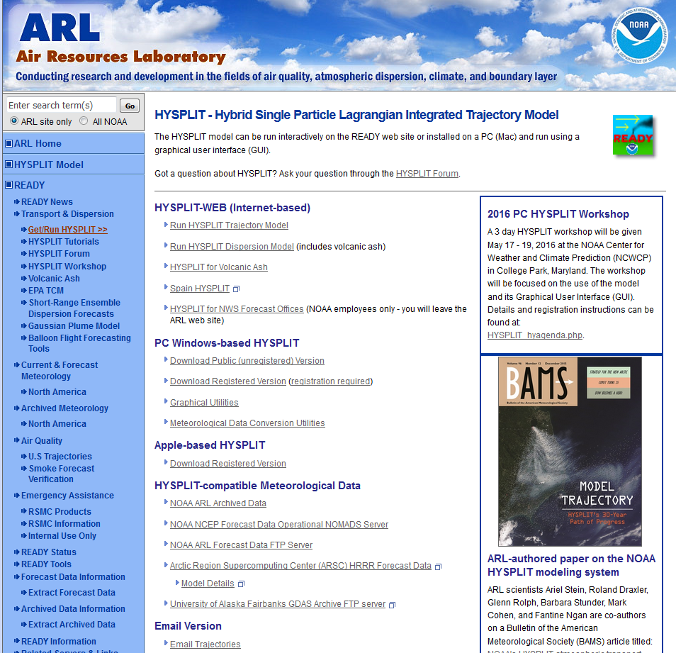
Notes:
We then click on the link to the operational (24/7) web site designed for WFOs to be able to run several types of atmospheric pollutant releases.

Slide 8
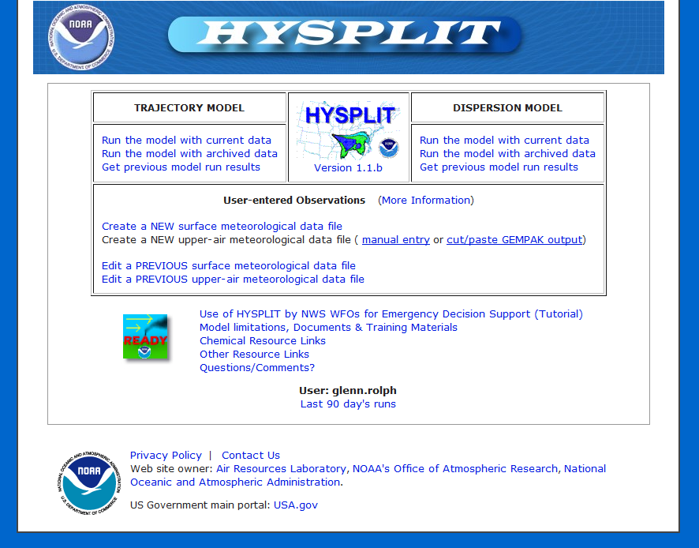
https://www.hysplit.noaa.gov
8
Notes:
The following slides will run through an example simulation of an ammonia release from a horizontal tank such as a railcar near Washington, DC.
https://www.hysplit.noaa.gov

Slide 9
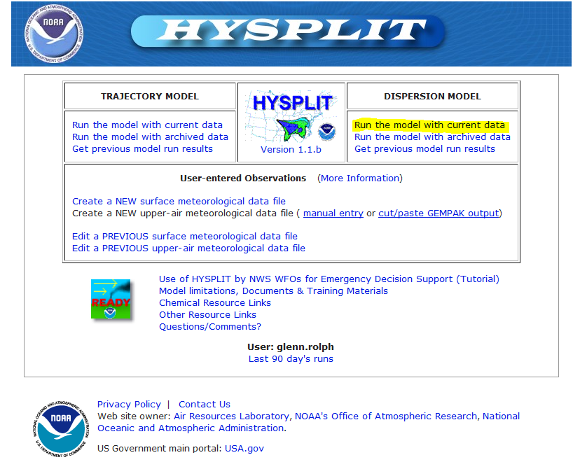
https://www.hysplit.noaa.gov
ARL Science Review, June 21-23, 2016
9
Notes:
Select the “run the model with current data” link.

Slide 10
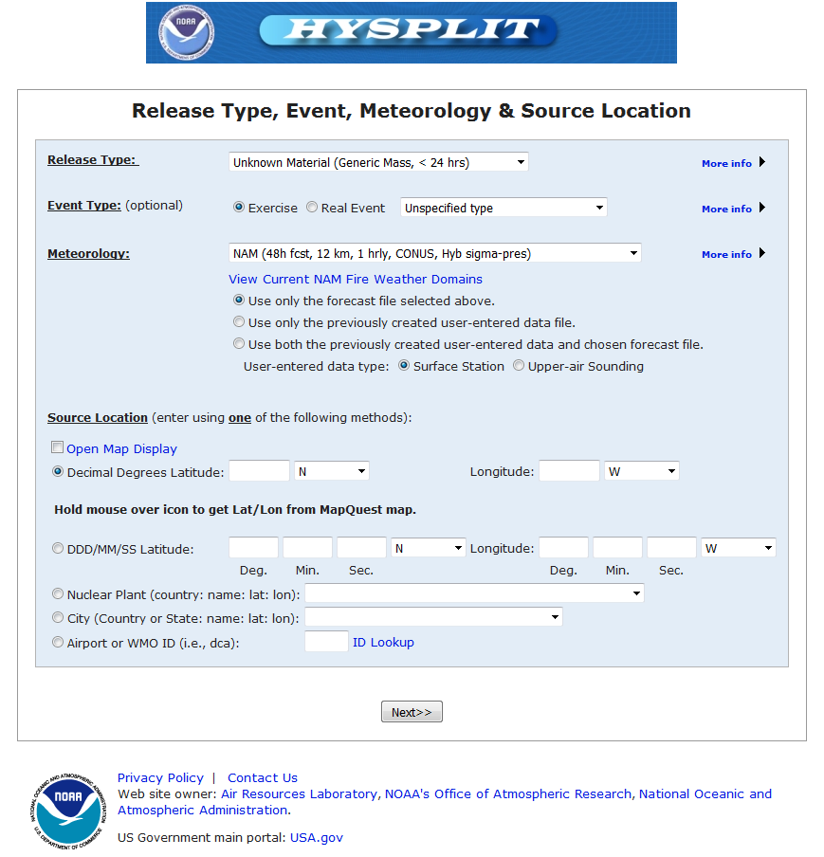
10
Notes:
Next, click on the Release Type drop down box.

Slide 11
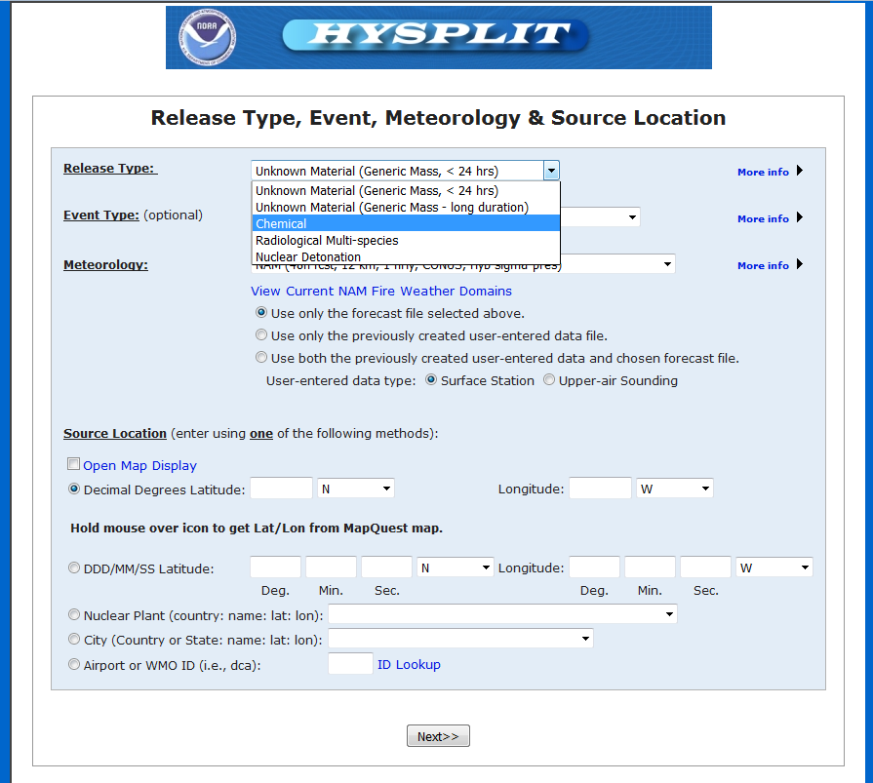
Choose chemical simulation (HYSPLIT/ALOHA)
11
Notes:
Choose the “Chemical” simulation option.

Slide 12
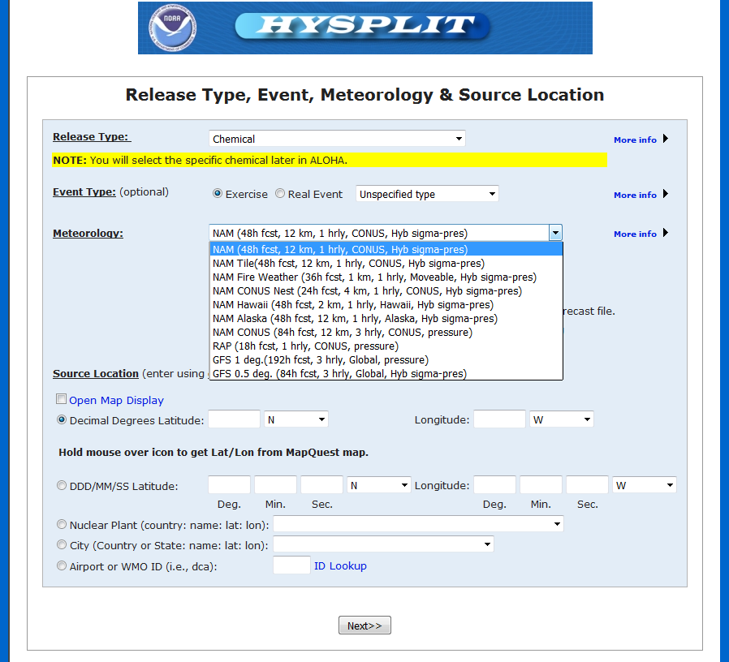
Choose meteorological forecast data
12
Notes:
Next, select a forecast meteorological data set appropriate for this scenario or choose the default.

Slide 13
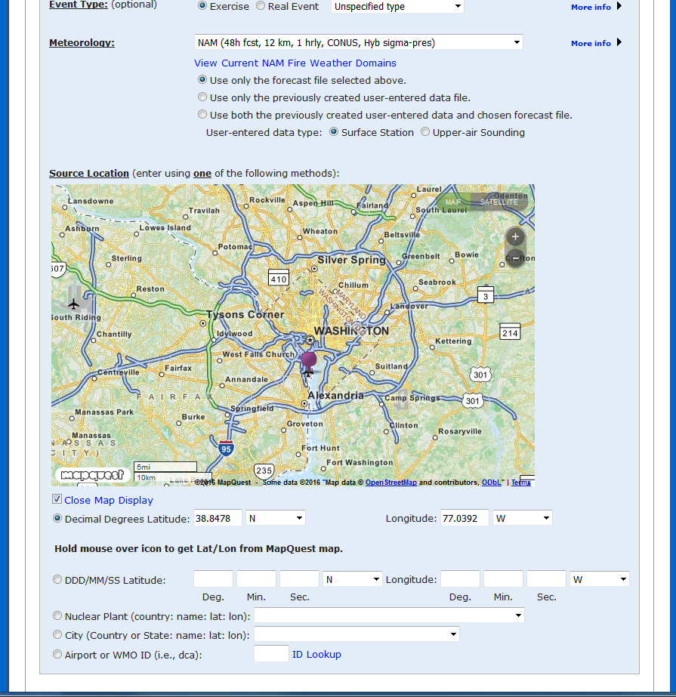
Choose source location
13
Notes:
Enter a source location either by clicking on the map or selecting a location from the user input and drop down boxes.

Slide 14
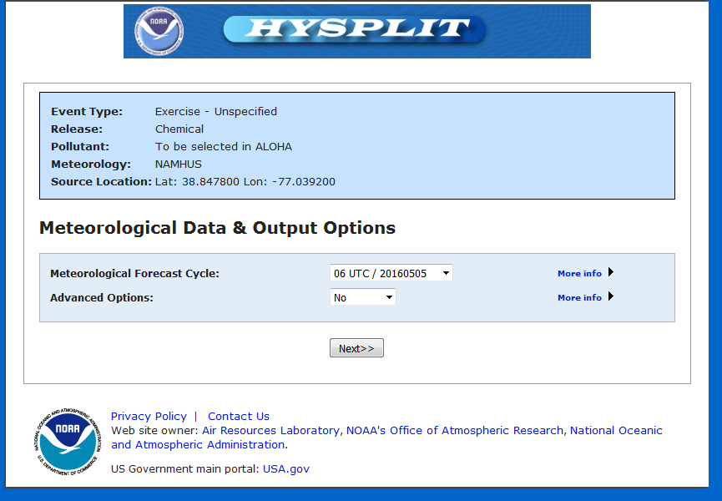
Optional forecast cycle and advanced options
14
Notes:
Click “Next>>” if the most recent forecast cycle is acceptable.

Slide 15
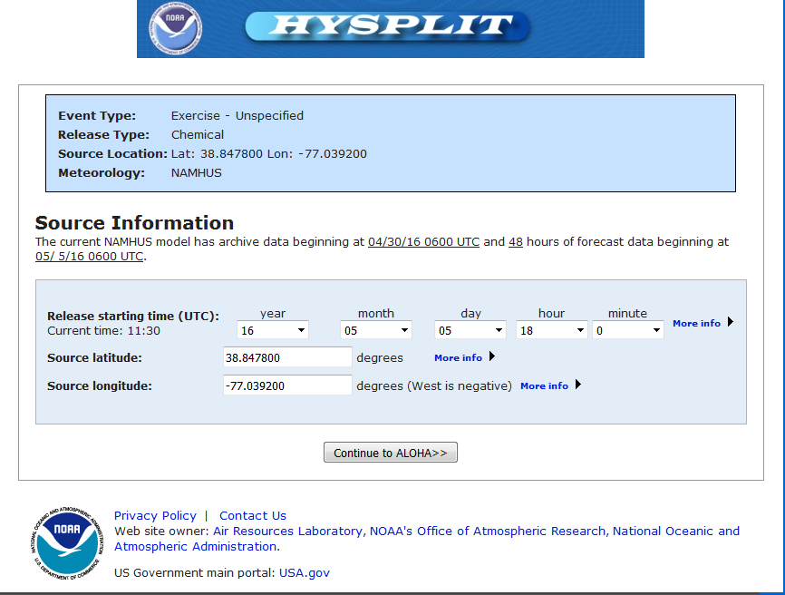
Set release time and/or refine latitude/longitude
15
Notes:
Refine the start of the release or the location and then select “Continue to ALOHA>>”

Slide 16
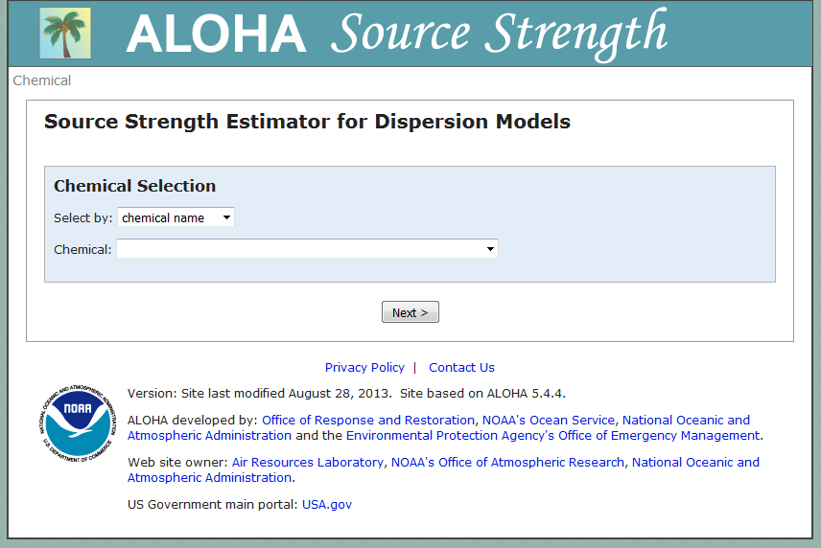
Enter ALOHA source strength calculation
16
Notes:
The user is now in the ALOHA Source Strength calculation pages.

Slide 17
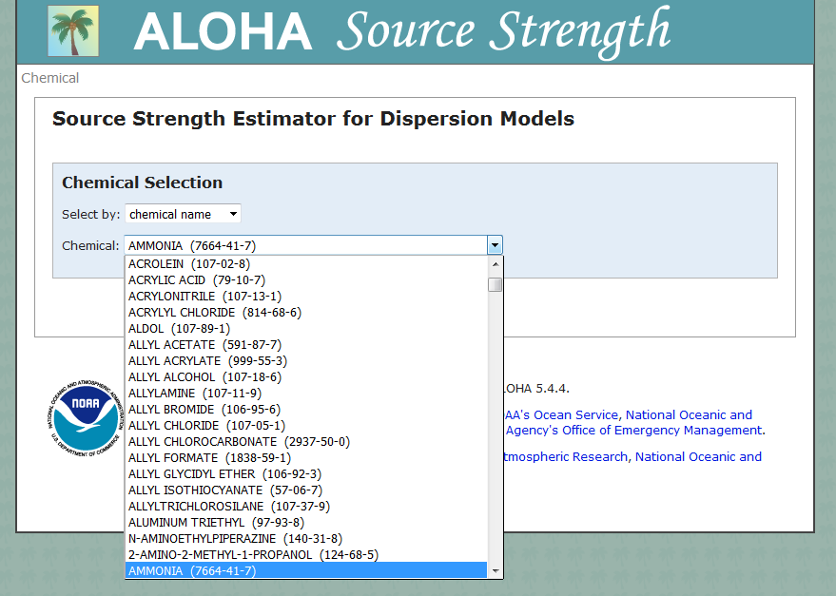
Choose chemical based on name from list
17
Notes:
Select a chemical from the Chemical drop down list (Ammonia).

Slide 18
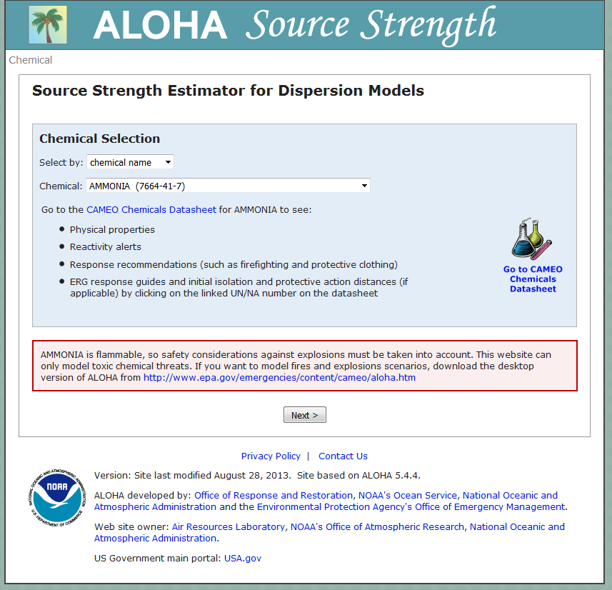
Links for additional information on the selected chemical is provided.
18
Notes:
Additional information on the selected chemical is available on the Chemicals Datasheet link.

Slide 19
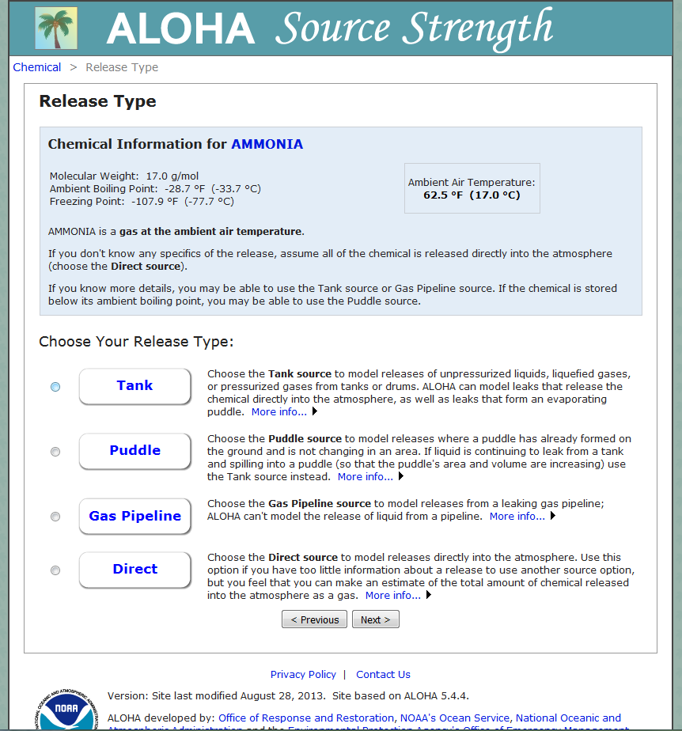
Chemical information for ammonia is provided at the top.
Choose the release type: Tank
19
Notes:
Choose the release type Tank from the four options.

Slide 20
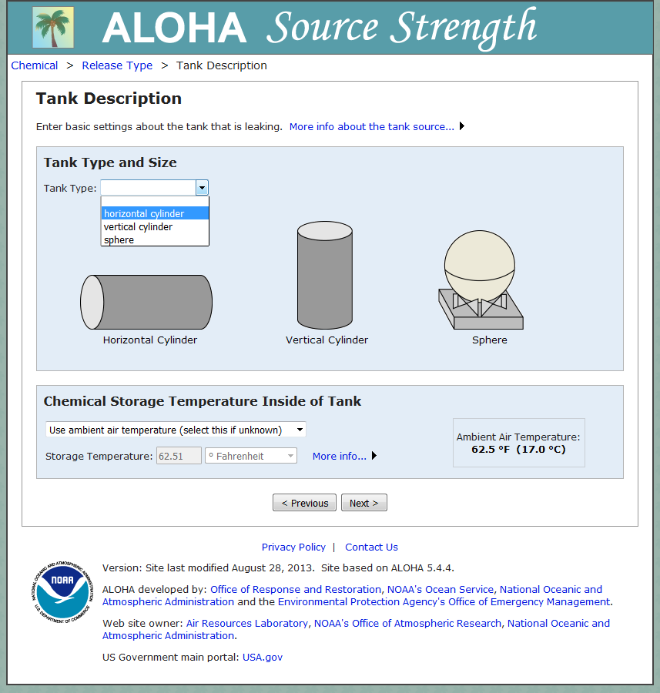
Choose the type of tank: horizontal cylinder
20
Notes:
Choose the tank type to be a horizontal cylinder to be similar to a rail tank car.

Slide 21
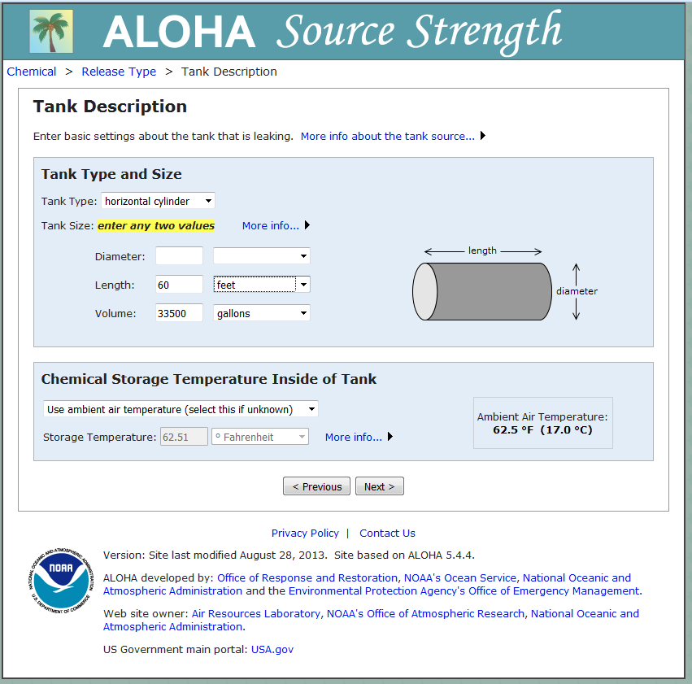
Enter any two values to define the size/volume of the tank.
Provide the chemical storage temperature if known and different from the ambient air temperature as obtained from the meteorological data.
21
Notes:
Enter the tank type and size as well as the chemical storage temperature inside the tank. Use the ambient air temperature from the meteorological model if unknown.

Slide 22
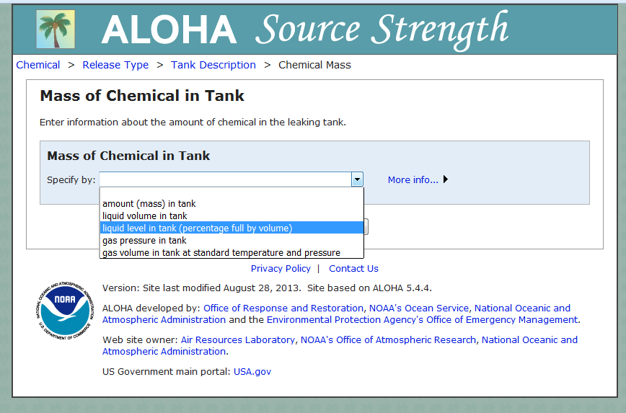
Define the mass of the chemical in the tank: liquid level in tank
22
Notes:
Select the best representation of the mass of the chemical in the tank. In this case select the liquid level in the tank.

Slide 23
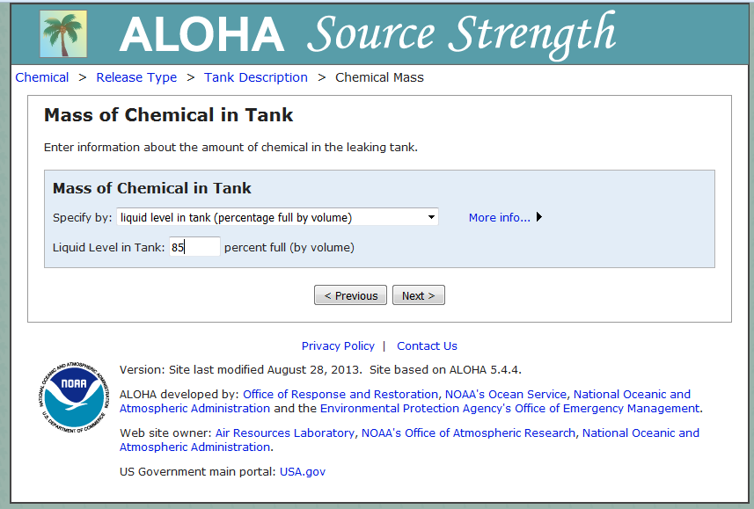
Liquid level in tank: 85 % full
23
Notes:
For a full tank car enter 85 percent full (by volume).

Slide 24
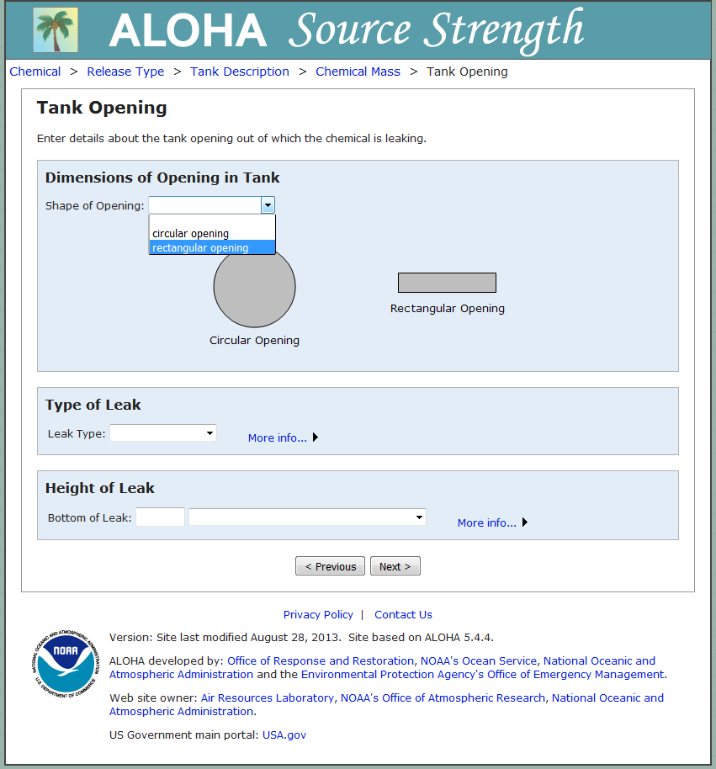
Define the shape of the opening in the tank: rectangular
24
Notes:
Select the rectangular opening for a hole in the tank.

Slide 25
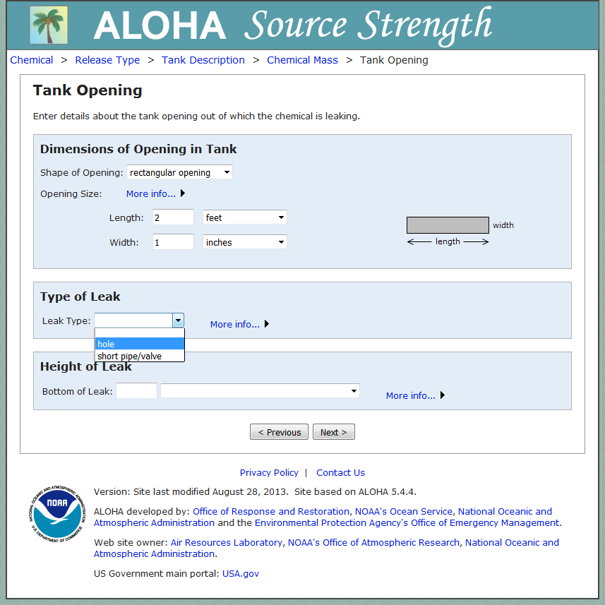
Define the size of the opening in the tank: 2 foot by 1 inch hole
25
Notes:
Enter the hole size of 2 feet by 1 inch and the type of leak is a “hole.”

Slide 26
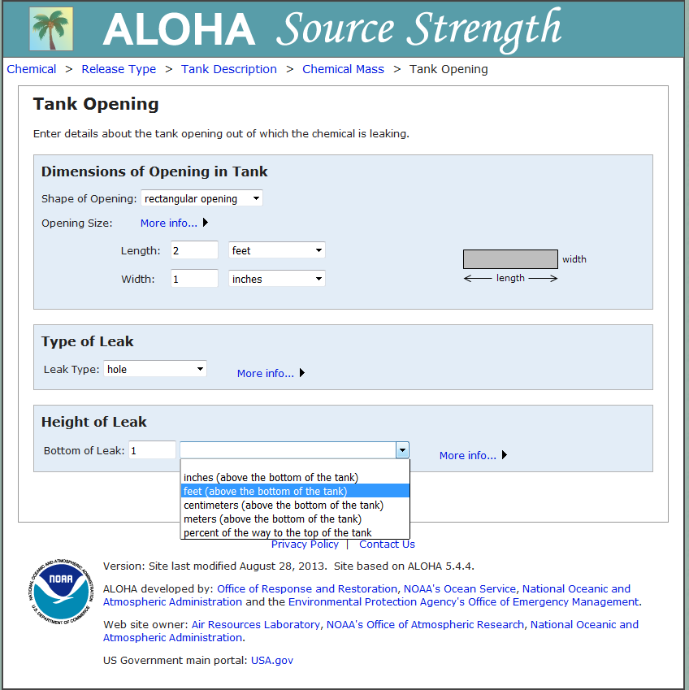
Define the height of the leak: 1foot above the bottom of the tank
26
Notes:
Indicate that the height of the leak is 1 foot above the bottom of the tank.

Slide 27
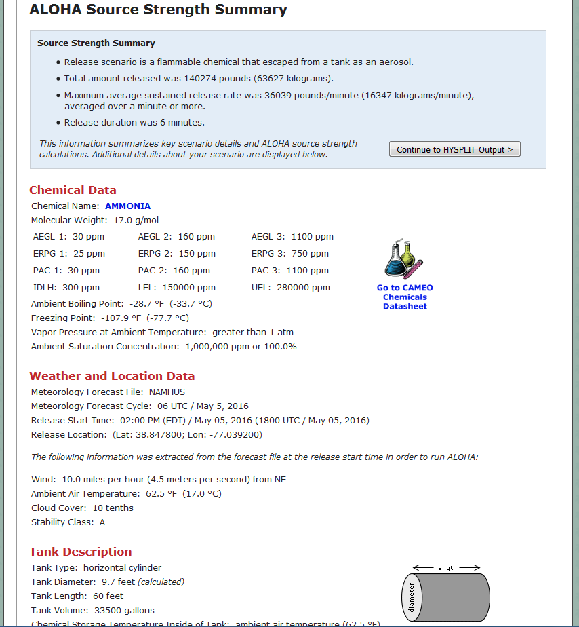
Summary of ALOHA source strength
27
Notes:
After entering all the information, make sure everything is correct on the ALOHA Source Strength Summary sheet.

Slide 28
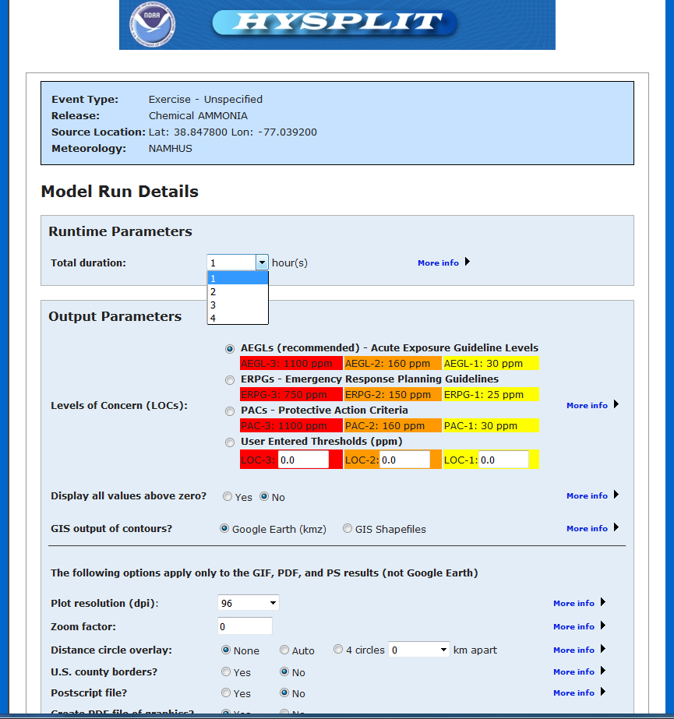
Set duration of HYSPLIT run: 1 hour
28
Notes:
Set the duration of the HYSPLIT run to be 1 hour in this example.

Slide 29
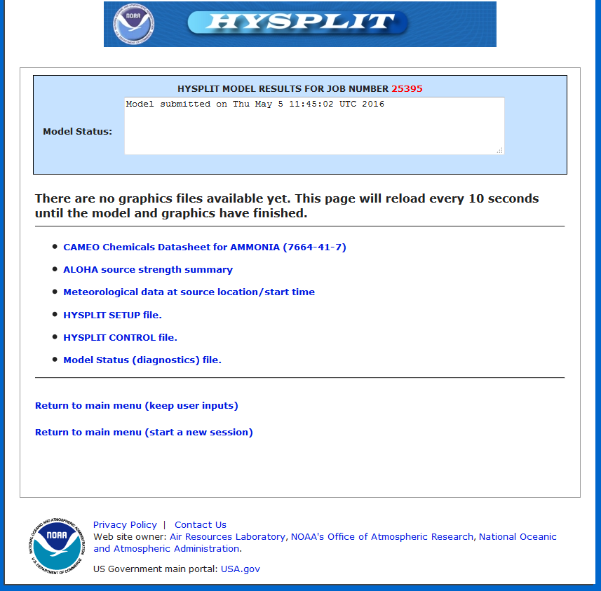
Model running
29
Notes:
Once you click “Request Dispersion Run” on the previous page, the model will be submitted and details of the run will be in the “Model Status” section.

Slide 30
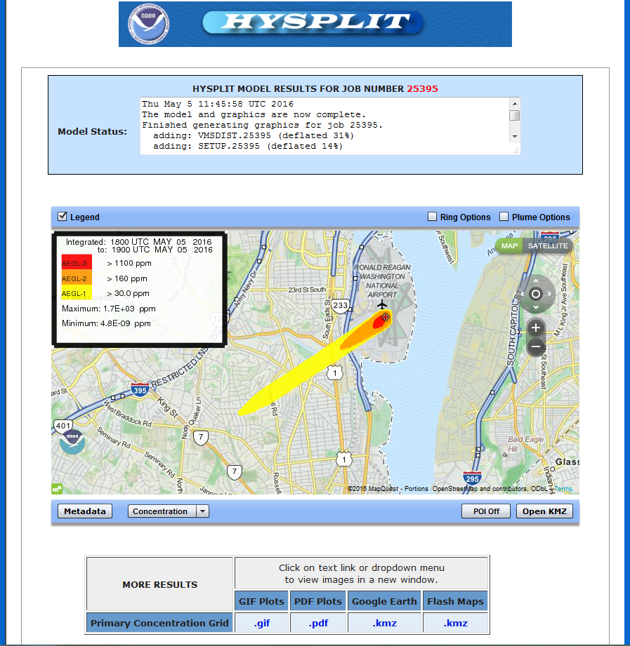
Model results showing levels of concern (AEGL)
30
Notes:
When the model finishes, a map showing the plume (if above the selected levels of concern) will be displayed with links to other output products.

Slide 31
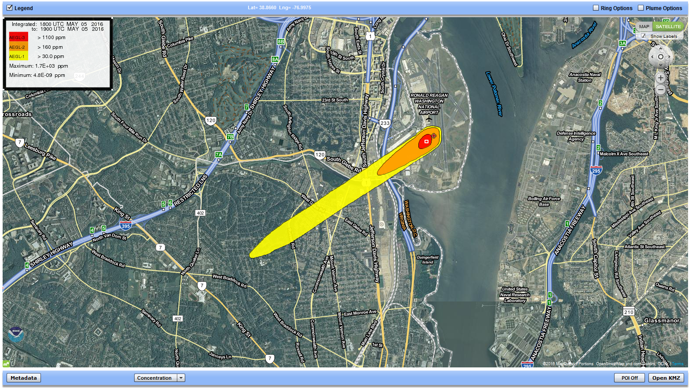
Model results displayed with ARL developed Flash interface
31
Notes:
This display is the model results on the MapQuest Flash interface developed at ARL.

